Slide 1
Software Requirements Specification
MoonEyes: Case Management System for Metro Detective Agency
Team 9: Kylie Callison, Erika Valle-Baird, Kendall Gresek, Pamela Shahu

Slide 2
1.0 Introduction: Goals & Objectives
Project | Document
To provide a searchable database of all case information To improve organization and centralize case and client details To improve information exchange between agents To increase efficiency when searching for case details To ensure that all data is kept secure Provide new marketing functionality via mass email | Serve as a guide for development Help us keep track of the product requirements and user stories throughout the development timeline. Allow our team and client to assess the quality of our finished product and ensure we have met all previously established requirements

Slide 3
1.0 Introduction: Scope
Database Creation | General Requirements
Client Tracking: Client name, address, phone number, attorney information,and additional notes. Case Tracking: Case numbers, Purpose, date, reports, photos/videos, and additional notes. Subject Tracking: Subject name, associates, phone number, place of work, vehicle information (license plate number, type of car), lawyer information, locations visited, repeated locations, background reports, photos/videos, and any other additional notes. Agent Tracking: Badge number and case numbers. | A way in which agents can log in with credentials A way in which agents can remotely access the system Ability to search for any parameter within the database A way in which data that was previously entered into the database can be clearly viewed A way in which an admin user can view audit logs A way in which mass emails can be generated A way in which PDF can be generated

Slide 4

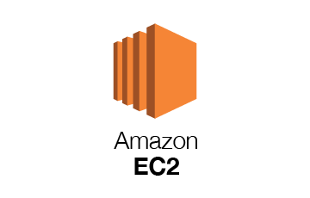

1.0 Introduction
Software Context
Deployment
Security
Major Constraints
Funding
Time
Experience

Slide 5
2.0 Usage Scenario- User Profiles
Users:
Admin
User
System
There will be two levels of users:
Full Control:
Administrator
Read Only:
General Public

Slide 6
Special Usage Considerations
Accessibility
Because the people using this software may be unfamiliar with case management systems, we should make sure the interface is easily navigable and understandable. We need to clearly display all information needed and possibly offer a help section or tutorial on how to use the software.

Slide 7
3.0 Data Model & Description
Data Objects
Client
A person who employs the Metro Detective Agency for a case.
Case
Each case will hold information containing its purpose, locations, media, retainers, agents working on each case, client for the case, and subjects for each case.
Subject
The subject of a case and relevant details such as place of work, vehicle, name, address, etc.
Agent
An employee of Metro Detective Agency who works on cases. An agent is allowed access to groups of clients under organization if admin has cleared them to do so.
Organization
Each organization contains groups of clients categorized by admin.

Slide 8
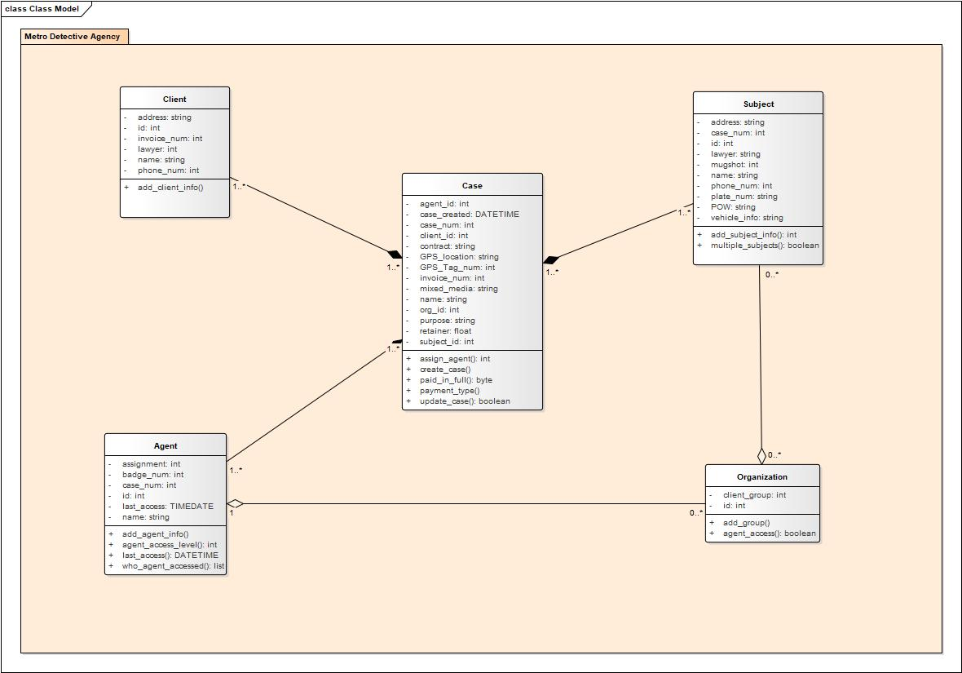

Slide 9
Relationships
 | Client | Case | Subject | Agent
Required |  | Client | Case
Optional | Case, Tags | Subject, Agent, Tags | Tags | Case, Tags

Slide 10
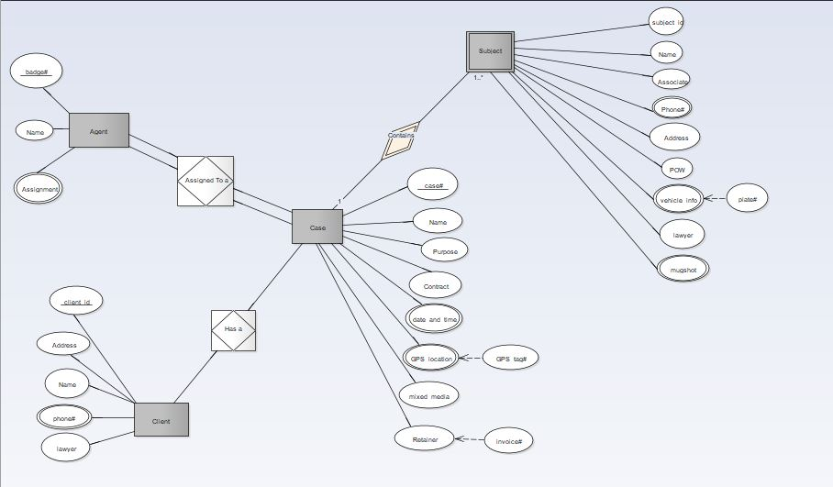

Slide 11
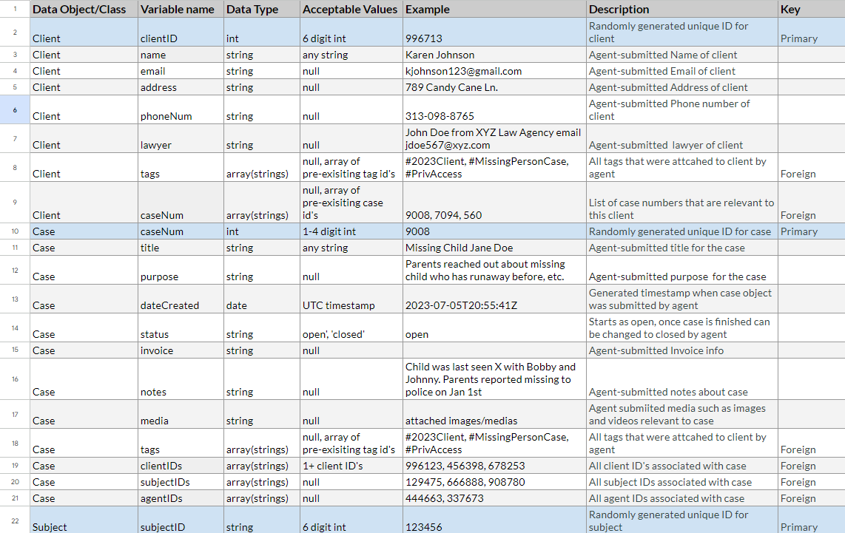
Data Dictionary

Slide 12
4.0 Functional Model & Description
Actors
Admin
An admin is any user of the system who is an employee and holds an admin account. An admin is informed about any changes to the system.
Agent
An agent is any user of the system who has a username, password, is an employee of Metro Detective Agency and holds an account.
System
The system is a database that contains client and agent information. The system is informed about client and agent updates so that is can provide up to date information.

Slide 13
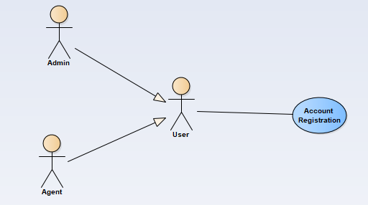
Two types of users exist within our system and hold separate types of accounts. An Admin has access to all information in our system, while an Agent has limited access specified by an Admin.

Slide 14
Account Registration
Use Cases
Description: This function allows users to register for an account with the system. The system will check the username, given by the user, is not a duplicate name in the current system’s database. The system will require necessary user data to create an account.
Preconditions: The user does not have an account.
Triggers: Account registration is triggered when a user selects the Account Registration button.
Scenario Description: The use case starts when a user indicates that he or she wants to register.
The system requests a username and password.
The user enters a username and password.
The system checks that the username would not be a duplicate of any existing registered usernames.
The system requests information about the user, specific to the account type.
The system starts a login session and displays a welcome message based on the username.
Postconditions: The user can now obtain client information. The user remains logged in until the “Logout” button is specified.
Exceptions: Account not created if a user is already registered under duplicate email in the system.
Account is not created if invalid information is inputted into any field.

Slide 15
Account Login
Use Cases
Description: This function allows users to login to the system. To confirm a user’s identity, the system will require both a username and password.
Preconditions: The user is registered and has a username and password.
Triggers:A user is logged into their account after inputting their username, password, and selecting the login button.
Scenario Description: The use case starts when a user indicates that he wants to login.
The system requests the username and password.
The user enters their username and password.
The system verifies the username and password against all registered users.
The system starts a login session and displays a welcome message based on the user’s account type.
Postconditions: The user can now obtain case and client information from the database .
The user remains logged in until the “Logout” button is specified.
Exceptions: User inputs invalid data more than 3x, account registered to that email is locked

Slide 16
Account Logout
Use Cases
Description: This function allows users to log out of the system, keeping their account secure.
Preconditions: The user or admin is logged into their account on the system.
Triggers:
Account Logout is triggered when a user, currently logged into the system, selects the logout button.
Scenario Description: The user selects the “Logout” button.
Postconditions: The user is logged out of their account.
Exceptions: The user does not select logout and is therefore logged out of the system after 60 minutes of inactivity.

Slide 17
User Management
Use Cases
Description: This function provides admin with the ability to edit case information, add cases, and save cases. Admin must be allowed to access reports, analyze user behavior, view and edit information, and assist users.
Actors: Admin
Preconditions: The user is logged in, the user’s account is an admin account.
Triggers:User management is triggered when an admin selects the edit button, allowing the user to edit case information. It is also triggered upon adding and saving cases.
Scenario Description: The use case starts when an admin selects the “User Management” button
The admin is then displayed with options to edit or add cases, view or edit client information, assist a user, and audit logs.
Postconditions: Any requested reports have been sent to a printing device or saved remotely.
All added and edited client information has been saved to the database.
Exceptions: Admin edits a case file with invalid information
Admin attempts to save a duplicate case.

Slide 18
Search
Use Cases
Description: This function allows an admin to search for case information. The system will check the information provided against cases in the database. The system will display all cases that match the provided information.
Preconditions: The user is logged in.
Triggers: Search is triggered when a user selects the search button after inputting search criteria.
Scenario Description: The “Search” button has been selected by the user.
The system displays entry fields for the user to input for search.
After a field has been entered, the system checks the details entered against information in the database.
If there are matches, the system displays matching case numbers to the details entered.
The user can then select which case they would like to view.
The system displays that case information.
Postconditions: All cases matching the search parameters are returned to the user who requested cases with certain criteria.
Exceptions: User inputs invalid search criteria

Slide 19
Update Account Information
Use Cases
Description: This function allows a user to edit their account information and change their password.
Preconditions: The user has an existing account. The user is logged in to the system.
Triggers: Update account information is triggered when a user selects the update account button after inputting up to date information.
Scenario Description: The “Edit Account” button has been selected by the user.
The system displays current account information, allowing for input from the user.
The user selects “Done”, submitting the changes.
Postconditions: The account has been updated and information saved to the database per user input.
Exceptions: Does not update if invalid information is inputted into any field.

Slide 20
Help
Use Cases
Description: This function provides a user with information pertaining to the functionality of specific sections within the system.
Preconditions: The user is on the company’s website.
Triggers: Help is triggered when a user selects the help button.
Scenario Description: The user selects the “Help” button.
Headers for each function are displayed to screen.
The user selects which function they would like information on.
The system presents a guideline to the screen describing the functionality and how to use that functions.
Postconditions: None
Exceptions: None

Slide 21
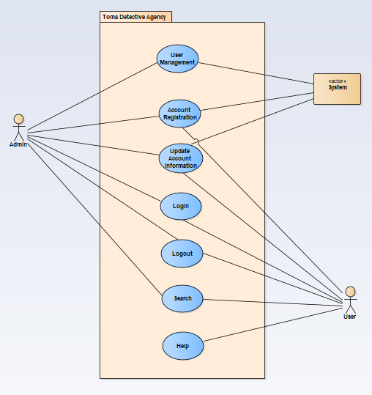
Overall Use Case Diagram

Slide 22
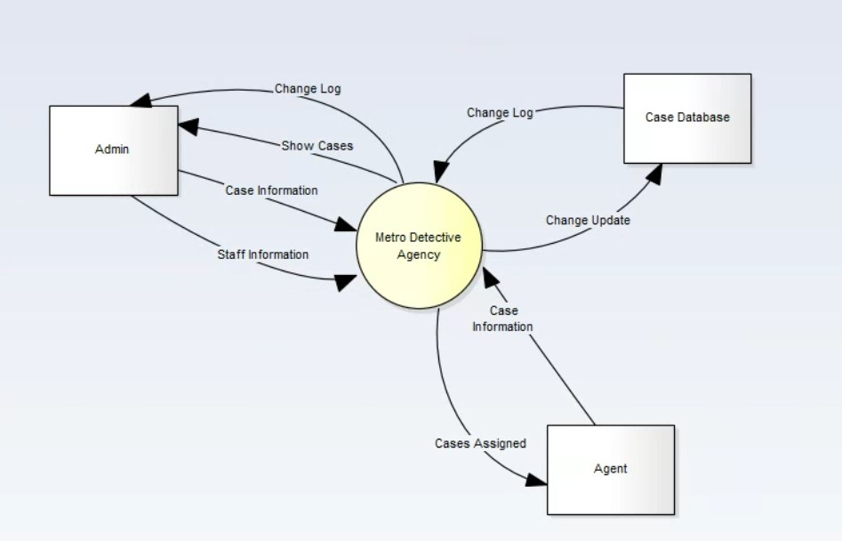
Software Interface Description
Metro Detective Agency’s software interface with the outside world are described with a graphical depiction of a data flow context level 0 diagram.

Slide 23
System Externals
Agent
An agent is any user of the system who is an employee, who is not an admin, nor holds an admin account. An agent may search for specific cases, update their information, and update case information. An agent who provides name, address, or other case details in a search query will receive the results of such a query if there is a match. An agent who searches or changes anything in the database will be logged for log records admin receives.
Admin
An admin is any user of the system who is an employee and holds an admin account. An admin is informed about case information. An admin also obtains logs of any changes made throughout the system. An admin who provides name, address, or other case details in a search query will receive the results of such a query if there is a match.The admin may update cases, change their information, and update and change agent information.
Case Database
The case database is a database that contains customer, case, and agent information. The case database is informed about case, customer, and agent updates so that it can provide up to date information.

Slide 24
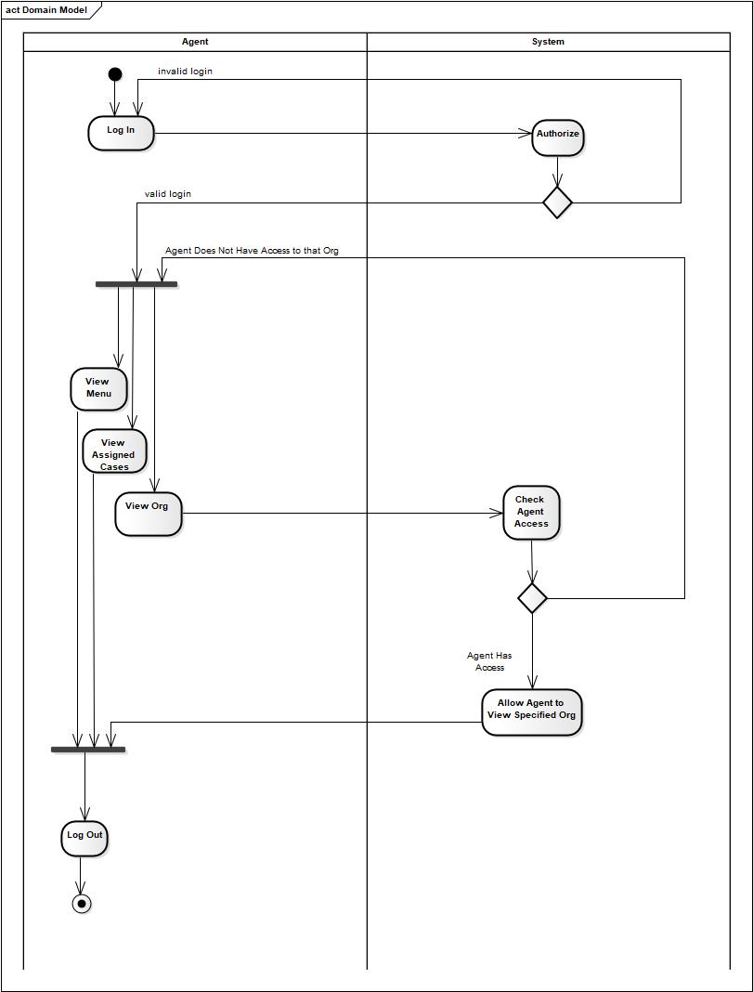
Activity Diagram
Activity diagram for an agent accessing an organization. After logging in and confirming login validity, an agent is presented with different menu options. Upon choosing to via an organization, the system checks the agent’s access type. If the system confirms the agent is allowed to access that organization, it allows the agent to via cases associated with the organization. If the system determines the agent does not have access to the organization, they are returned to the regular menu.

Slide 25
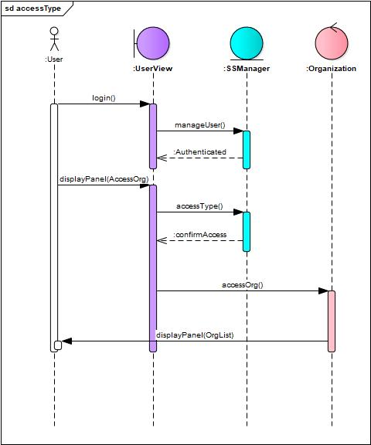
Sequence Diagram
Agent accessing an organization.

Slide 26
Events-A listing of events (control, items) that will cause behavioral change within the system is presented. | States - A listing of states (modes of behavior) that will result as a consequence of events is presented.
User Registration | System Initialization
User Login | User Registration
User Logout | User Login
Case Creation | User Logout
Case Update | Case Creation
Search Query | Case Modification
Report Generation | Search Results
Email Generation | Report Generation
Admin Access | Email Sending
Audit Logs | Admin Access
 | Audit Log Recording

Slide 27
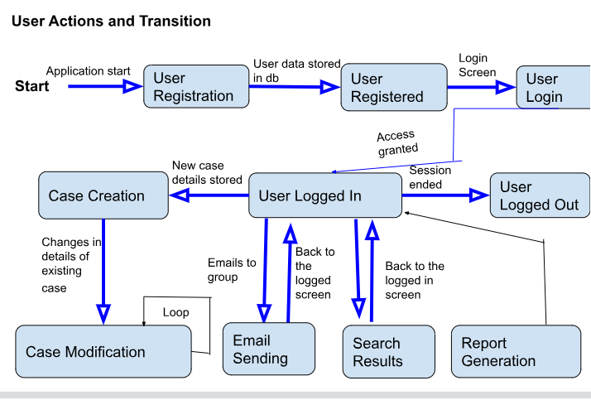
5.2 State Transition Diagrams

Slide 28
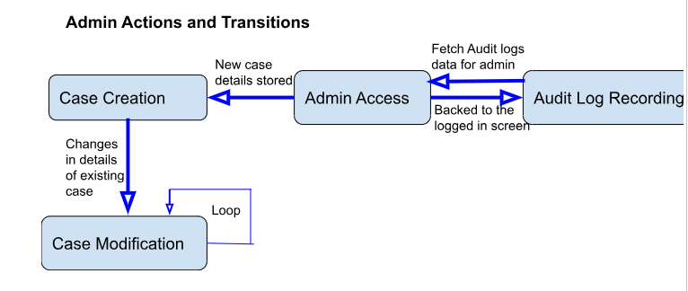

Slide 29
5.2 State Transition Diagrams

Slide 30
5.3 Control specification (CSPEC)
User Authentication - Granting access to only authorized users
User Roles and Permissions - Admin has more permissions and has all the management access in the system.
Access Control List - The system uses the ACL system to control the permission that which user can perform which tasks
Session Management - This is to control the system access to only authorized users. The session ends when a user logouts.
Workflow and Business Rules - It’s about the control over the system and all the actions that are performed are in sequence and being performed step by step
Data Validation and Error Handling - To maintain the quality performance of the system, error handling and error prevention are implemented
System Configuration -The configuration option is for the admin who can change the settings and rules and policies of the software.

Slide 31


6.0 Restrictions, Limitations, and Constraints
Funding
Cloud-based web service costs anywhere from $10 to $50 a month
Time
8 month long project. This could impact improvements and additional features
Experience
The team member’s experience is limited in the area

Slide 32
7.0 Validation Criteria
Classes of Tests | Expected Software Response
Black-Box Testing Unit Testing Integration Testing Performance Testing Validation Testing | Performance Testing: System able to handle traffic & usage Unit & Integration Testing: Small errors and bugs that are easily detected and fixed in development process

Slide 33
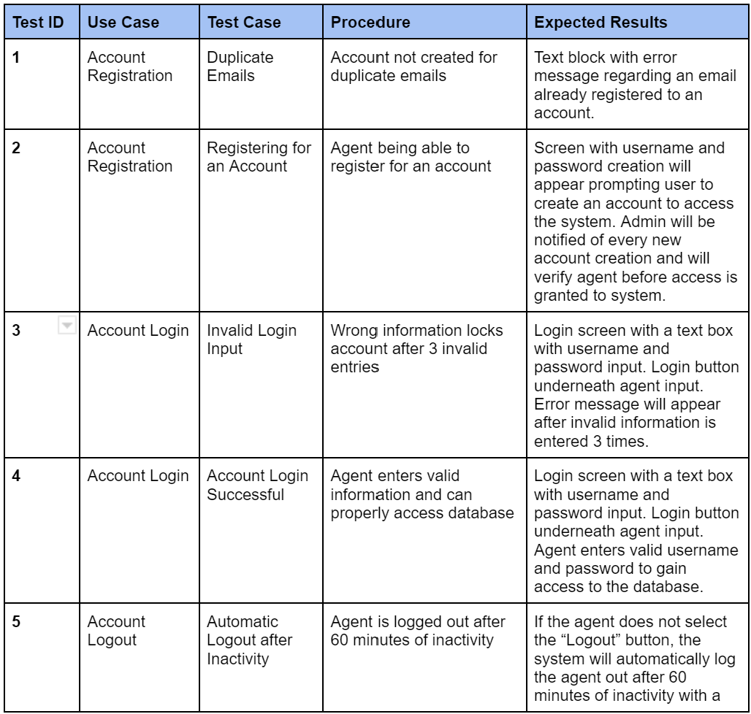
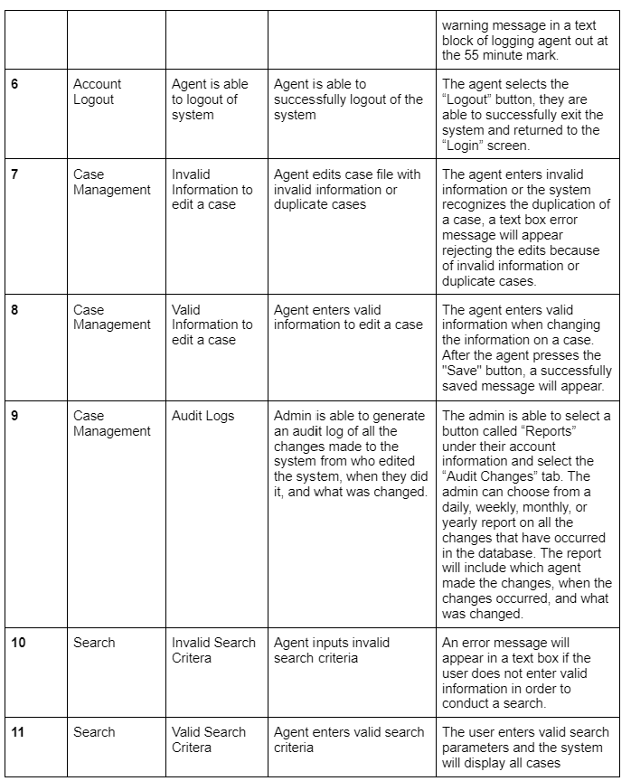
7.2 Expected Software Response: Black Box Testing

Slide 34
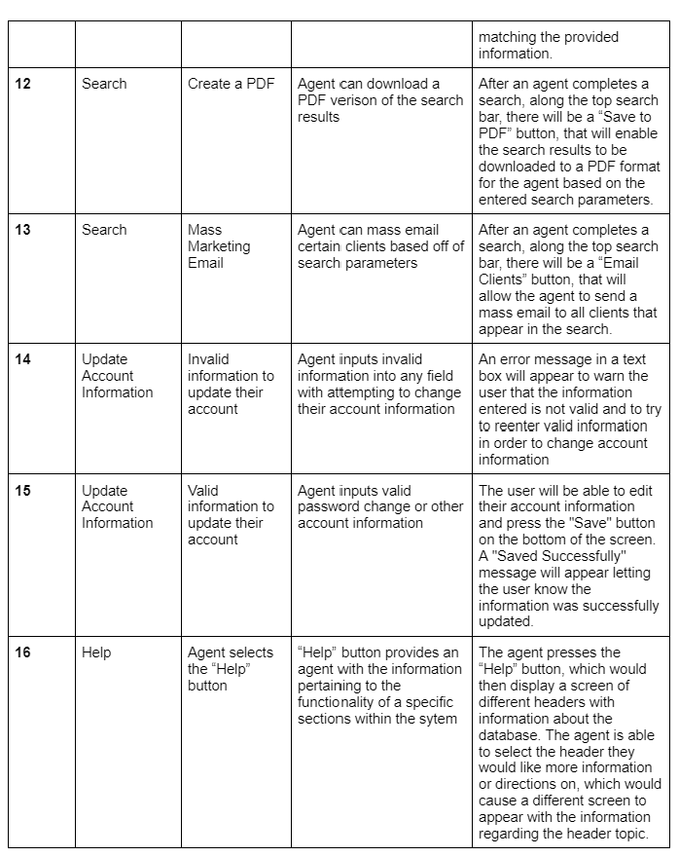
7.2 Expected Software Response: Black Box Testing

Slide 35
7.3 Performance Bounds
3-4 agents using system on a weekly or daily basis
Number of agents will possibly grow over time
Amount of cases agents work on a year ranges from 10 to 300, depending on complexity
Investigations can take anywhere from 1 to 20 hours of labor
System will need to be able to handle a variety of cases
Admin will need to be able to generate audit logs on information being changed in the database

Slide 36
8.0 Appendix
Presents information that supplements the Requirements Specification
System traceability matrix
Product Strategies
Analysis metrics to be used
Supplementary information (as required)

Slide 37
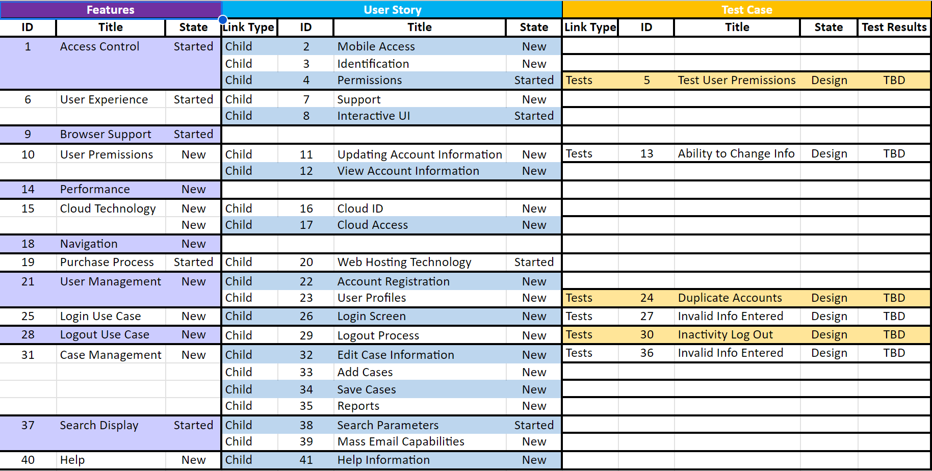
8.1 System traceability matrix

Slide 38
8.2 Product Strategies
User-Focused Design: System users like admins and agents must have a user-friendly and easy-to-use interface so they don’t face any difficulties while performing a task.
Data Security and Privacy: The system should meet security and protection standards and implement a reliable user authentication that has a secret encryption function to keep the passwords and protection keys safe.
Remote Access and Cloud Deployment: According to the requirements system must be available for users from any place and any system like computers or mobile phones so they can perform their tasks remotely.
Comprehensive Case Tracking: The agent is one of the main stakeholders of the system, he should be able to add data about the new clients and cases.

Slide 39
Reporting and Communication: The feature of generating reports in pdf form also should be available for agents and they should be allowed to send these reports to clients and related authorities. Audit Logs and Admin Controls: There should be also an admin of the system who has access to all the information and changes agents do in the system.
Scalability and Performance: The system must have the ability to deal with a large number of users.
Documentation and Training: To provide a better user experience there must be documentation for users to guide them on how to use the system and how they can perform their desired task.
Continuous Improvement and Maintenance: For the system's betterment and improvement there should be user feedback and in case of bugs and errors it also will help to improve system performance.

Slide 40
8.3 Analysis metrics to be used
User Adoption Rate: To know about the system's acceptability we use the user adoption rate matrix because this is based on the number of sign-ups and signs on the system during a particular time frame. It’s directly proportional to the system's acceptability. User Engagement: User engagement as it’s clear by its name that it’s about the user interaction on the system. We use this metric to calculate how much the system is useful for the users.
System Performance: To ensure the full use of the system it’s a must to keep check on system performance.
Error Rate: To improve the software every day and make it more efficient we need to reduce the bugs and errors in the system, that’s why we use this metric to solve the bugs in software.
Search Efficiency: It's one of the main features of this software because whenever a user would track a case or admin or other users want to see some information or data.
Security and Privacy: Security is the one of the main aspects of the system so to ensure the protection of the data from unauthorized users

Slide 41
8.4 Supplementary information (as required)
User Feedback: To improve software quality and performance user feedback is very crucial because they are using it in an actual environment and can give a fair opinion about the performance and issues in the system.
User Demographics: For a better understanding of the unique demands and preferences of users of the system it will be helpful to learn about the demographics of the end user. Training and Support Materials: For better user experience this is the best idea to give the training and some helpful material that will help them to use the system and perform their specific tasks using this software.
System Usage Data: Collecting data on system usage can provide valuable insights into user behavior and patterns.
System Updates and Enhancements: Changes according to the needs and feedback of the users must be kept on record because that is the record of how we have upgraded the system as per the end user’s needs.

Slide 42
References
R. S. Pressman, “Document Templates: Software Requirements Specification,” R.S. Pressman & Associates, Inc.. [Online]. Available: http://www.rspa.com/docs/Reqmspec.html. [Accessed: 14-June-2023].
“Software requirements specification,” McGraw Hill Higher Education. [Online]. Available: http://www.mhhe.com/engcs/compsci/pressman/graphics/Pressman5sepa/common/cs1/sw-req.pdf. [Accessed: 14-June-2023].
Pressman, Roger S., and Bruce R. Maxim. Software Engineering: A Practitioner's Approach . Vol. 9, McGraw-Hill Education , 2020.

Slide 43
THANK YOU!

